Slide 1
JS Build Systems & Task Runners

Slide 2
Why Use a Build System / Task Runner?

Slide 3
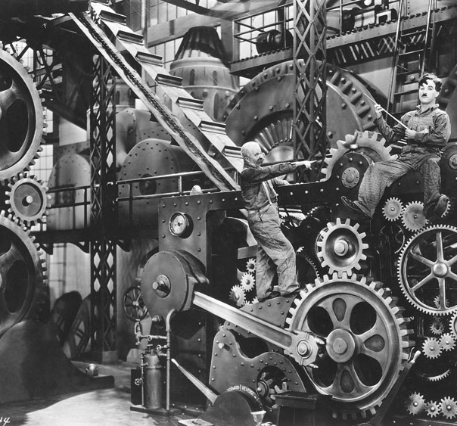
Build Systems Automate routine Tasks.
> Compiling JS Files
> Compiling CSS files
> Concatenating/minifying files
> Linting
> Optimizing Images
> Providing a Dev Server
> Anything you do as a Routine Task, Pretty Much,

Slide 4
Which one is Best for you?

Slide 5








There are many from which to Choose

Slide 6

It All Depends on What you want to do.
In our case we want to…
> Write Code using ES6 Module Syntax
> Transpile JavaScript Files to Run in any Browser
> Compile Sass
> Implement a Dev Server
> Create our Build Files
> Be Simple

Slide 7
We’ll Combine Two

